Slide 1


iPad Restaurant Application
By: Sunil Tumkur,(100620430) Eric Tsim(100560172) and Harshwardhan Goswami (1006547360)

Slide 2
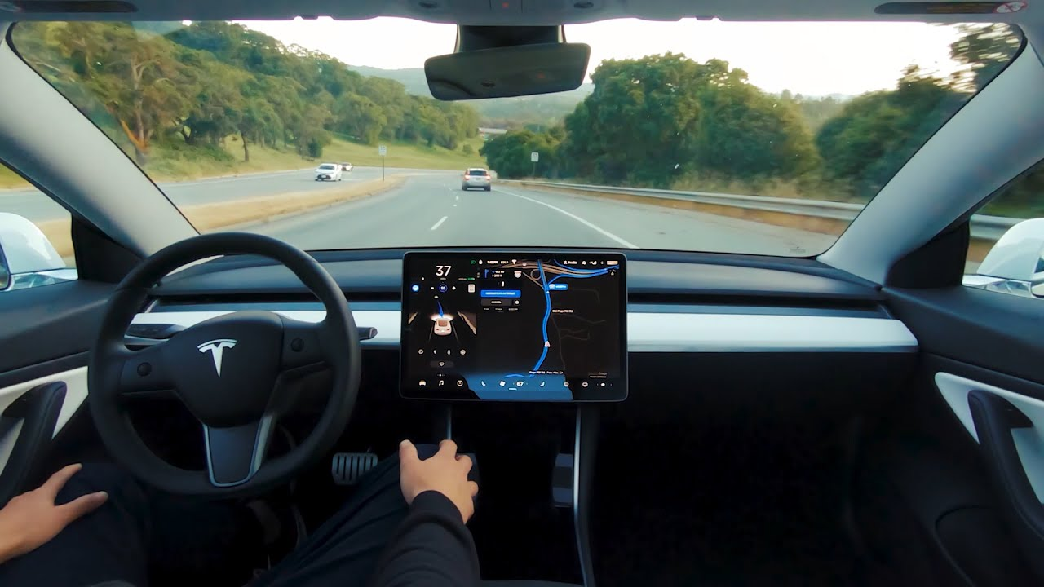
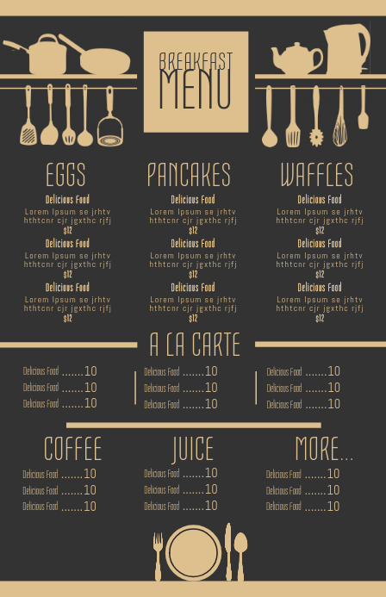
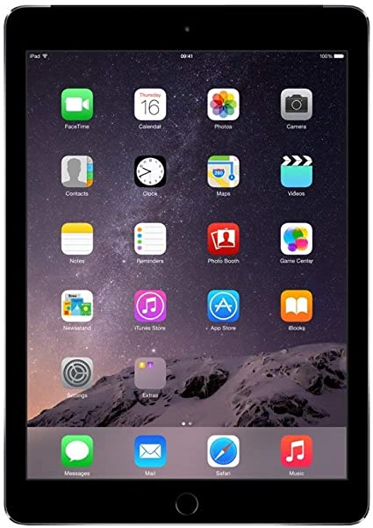
Introduction
With the recent surges in technology like self-driving cars and automation, we believe it’s time the restaurant-industry took a step towards the future
The original menu system of reading a paper menu and a waiter taking your order is a bit outdated so our idea is to change the menu system from conventional paper to an online menu system.
On the application itself, we’d have pictures of dishes along with their name, description, rating and price

Slide 3

Objectives and Measures of Success
Improve the overall customer experience
Customers are often uncertain of what to order due to their lack of knowledge of the restaurant's food selection and specialties. We see this issue as more of a communication issue from the restaurant side than a customer issue as the restaurant should make the restaurant experience as smooth as possible for the customer.
The customers are given a survey after their meal with regards to their experience. Upon completion, customers are given a discount for their next meal.

Slide 4
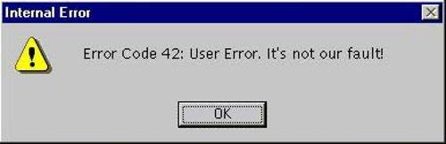
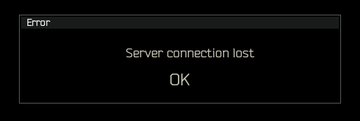
Risks
The compatibility between the software and the hardware
Requirements may not be fully defined
Meals storing improperly due to security and socket issues
Long-term maintainability

Slide 5
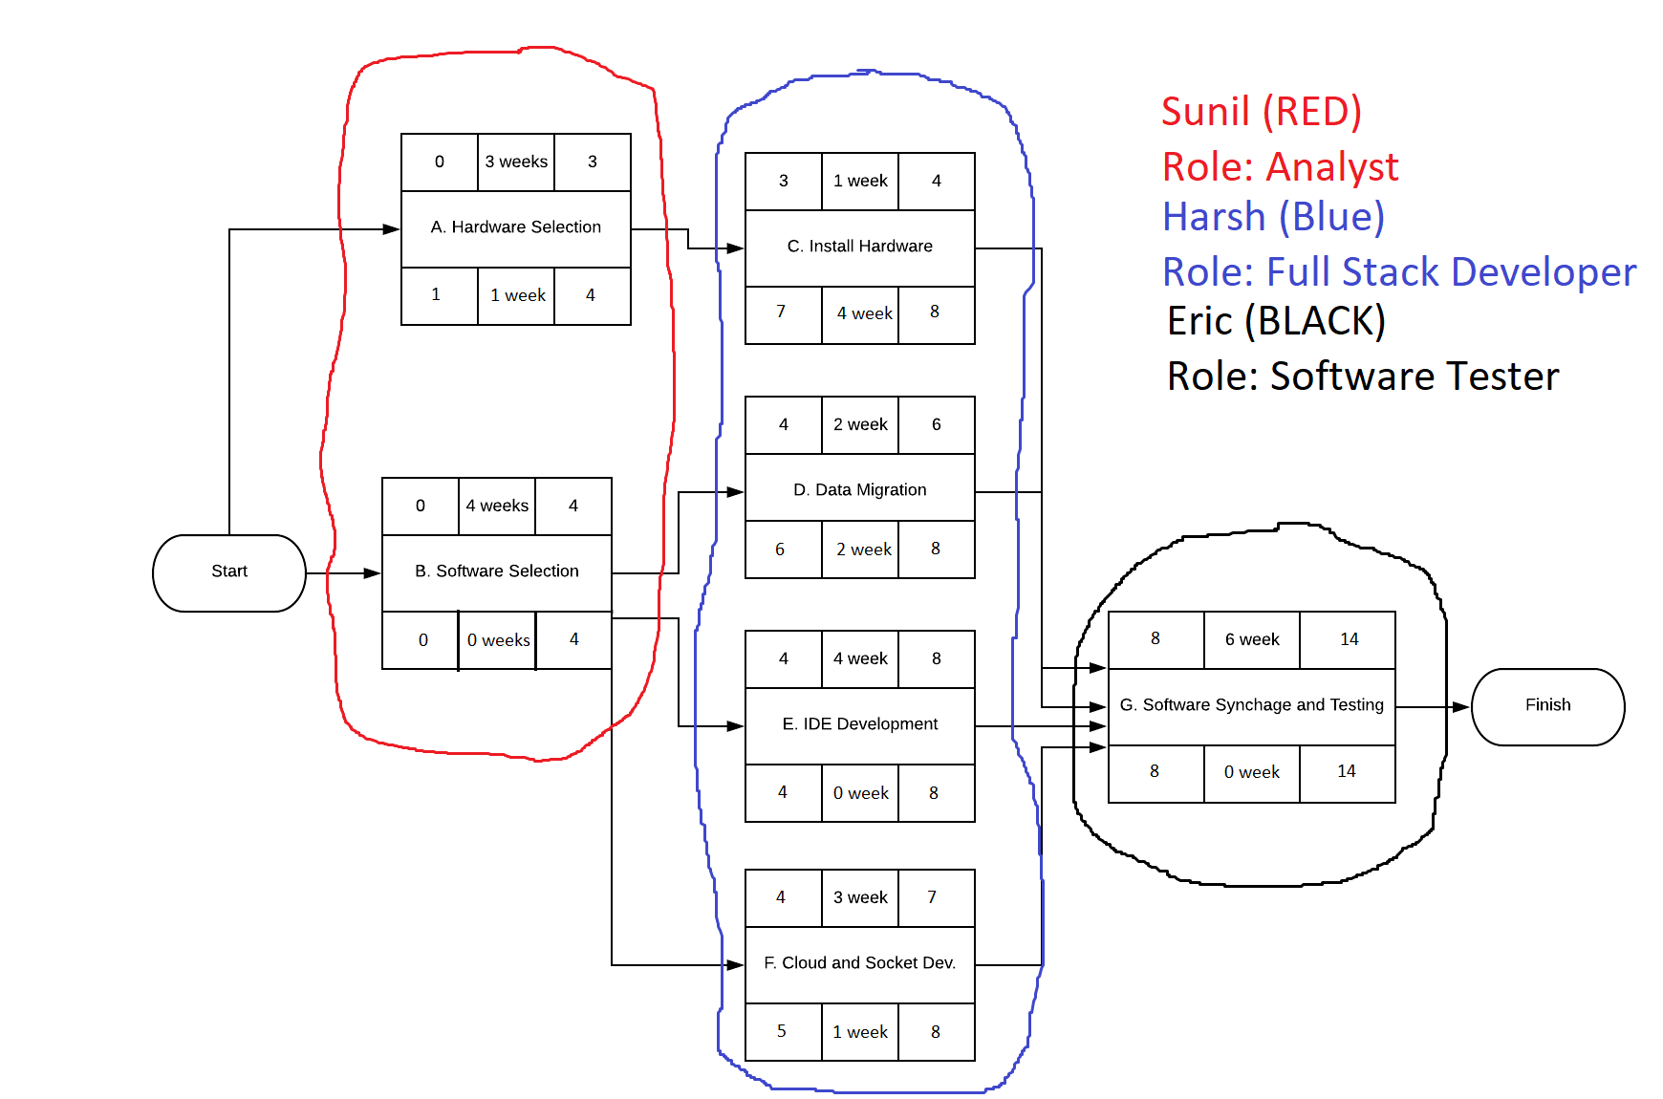
Activity Diagram and Roles
Steps to complete project
Select the model of iPads to be implemented for the restaurant
Select the types of software to be used (e.g. MySQL vs MongoDB) for this project
Migrate all of the menu data into the online database
Develop the iPad application IDE for the online-menu system
Implement security measures for the application and database to combat packet-sniffers
Integrate the iPad application and the online database together
Test all test cases and functionalities of the software

Slide 6

Thank you for your time
Stay Safe

